Slide 1

Master of Decision Analytics- Professional Track
April 19, 2019
VCU Team: Ryan Hawkins, Kyle Jacobs, Mallika Rodriguez, Yasin Seddiq
Virginia Premier Representative: Kyle Hawk

Slide 2


Executive Summary
Objective: Reduce Emergency Department (ED) usage through Care Coordination
Strategy: Use Random Forest classifier to identify VP members likely to use the ED in an upcoming visit
Results: Deployable model identifies members mostly likely to use an ED in an upcoming visit
Notes:
Premise: Care coordination can help reduce preventable ED visits
Assumptions: Members will seek non-ED medical care services if encouraged by care coordinators
Approach: Prioritize certain members for care coordination outreach

Slide 3

Objective
Prioritize Virginia Premier (VP) members for Care Coordination.
Premise: Care coordination reduces Emergency Department (ED) visits
Assumption: No resource constraints.
Guidance from VP: Look into chronic conditions and comorbidities
Challenges: HIPAA constraints, memory constraints, processing costs
Notes:
Image source: https://www.indeed.com/salaries/Care-Coordinator-Salaries-at-Virginia-Premier
Premise: Care coordination can help reduce preventable ED visits
Assumptions: Members will seek non-ED medical care services if encouraged by care coordinators
Approach: Prioritize certain members for care coordination outreach

Slide 4
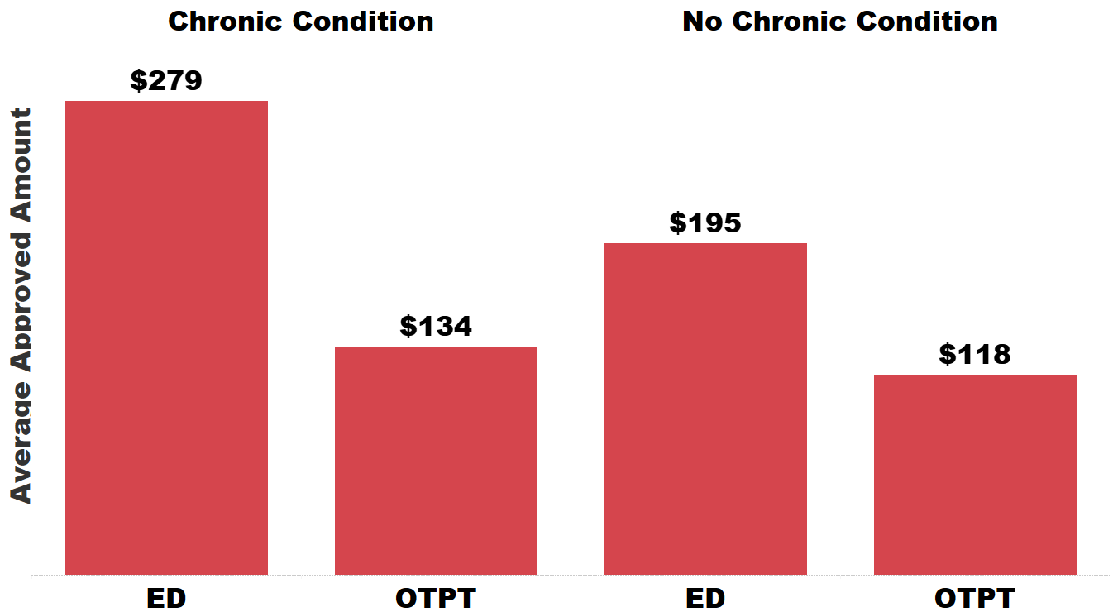
Average Cost of Treatment

Slide 5
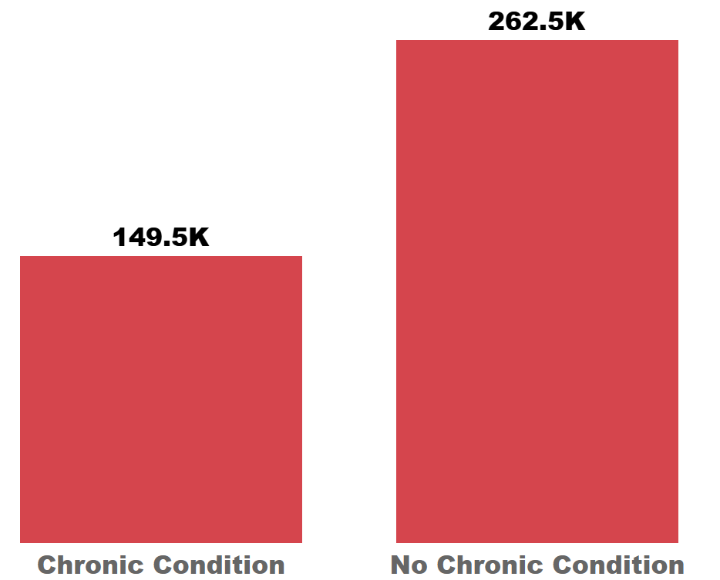
Members with a Chronic Condition

Slide 6
Creating the Dataset
clean_claims(data)
get_chronic_condition(data, splits)
get_upcoming_visits(data)
impute_ccs(data, splits)

Slide 7
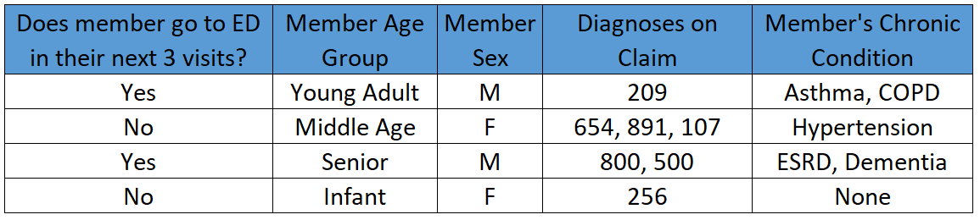
Model Dataset

Slide 8
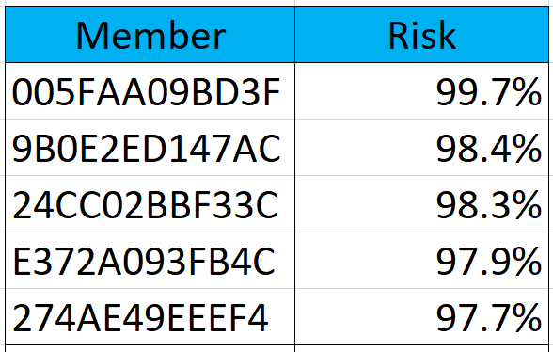
Model Output

Slide 9
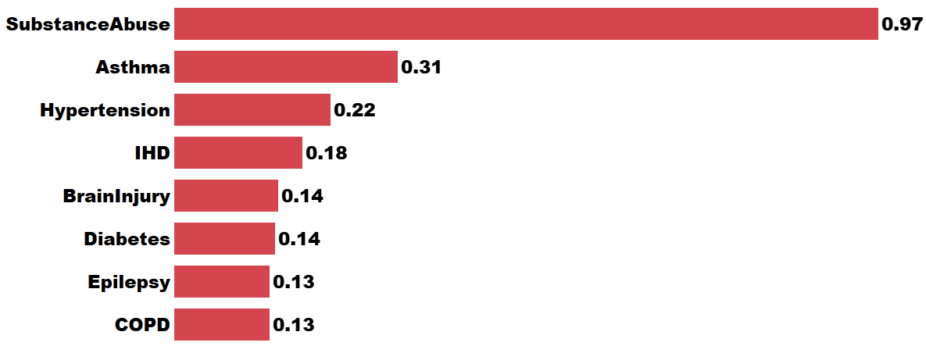
ED Usage Ratios
5%
40%
25%
28%
63%
39
50%
45%
Note: ED Usage Ratio = ED Usage / Outpatient Usage

Slide 10
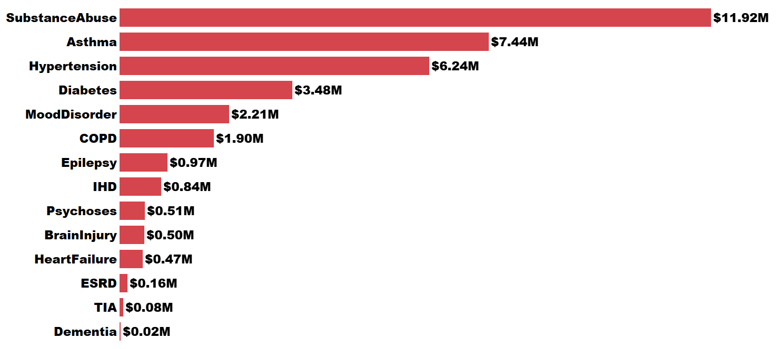
ED Costs by CC Diagnosis

Slide 11
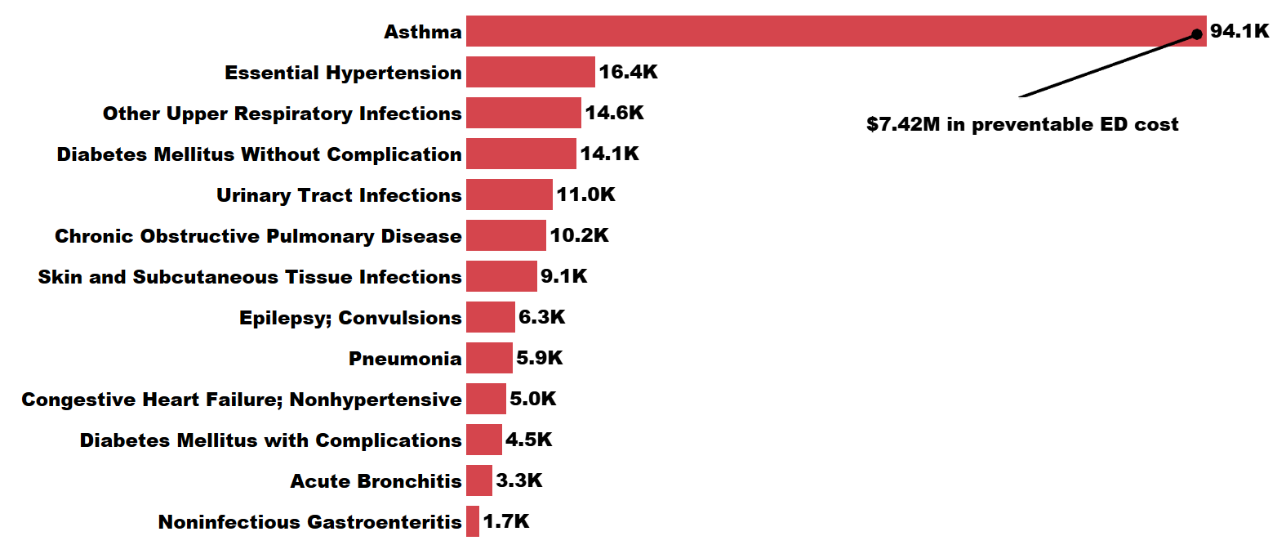
Preventable ED Visits

Slide 12
Next Steps
Develop strategy for deploying model internally
Optimize model by adding in other proprietary information (i.e., HIPAA, location, precise date/time)
Train Care Coordinators on how to implement prioritization framework
Run model on a regular cadence to re-train data
Continue exploring emerging research related to preventable ED usage

Slide 13
Questions?

